Slide 1
Discrete-Event Simulation
Discrete-event simulation is a method where we model a system as it changes over time. In this approach, the system's state variables change suddenly at specific points, known as events. This means that the system only changes at certain moments when these events occur. An event is a small occurrence that can alter the system's state. Here, "state" refers to the current condition of the system, like whether a server is busy or idle.
Example :
Imagine a barbershop with only one barber or an information desk with only one operator. Here, we want to find out how long, on average, customers have to wait in line.
For this model, some important things to consider are:
Server's status: The server (barber or operator) will either be idle or busy.
Number of customers in the queue: How many customers are waiting.
Each customer's arrival time: The exact time when each customer enters.

Slide 2
In this example, there are two events:
1. Customer arrival: This event changes the server's status (from idle to busy) or increases the number of customers in the queue.
2. Service completion (departure): This event changes the server's status (from busy to idle) or decreases the number of customers in the queue.
Real-World Example: Airport Check-In Counter
Imagine a check-in counter at an airport with one staff member assisting passengers.
- State Variables:
- Counter Status: Either busy (helping a passenger) or idle (no passenger at the counter).
- Queue Length: Number of passengers waiting to check in.

Slide 3
Events:
- Passenger Arrival: A passenger arrives at the counter.
- If the counter is idle, the passenger is served immediately.
- If the counter is busy, the passenger joins the queue.
Service Completion: The staff finishes checking in a passenger.
- If passengers are waiting, the next in line is served.
- If no one is waiting, the counter becomes idle.
Outcome:
By simulating this process, the airport can estimate how long passengers typically wait in line and decide if they need more staff during busy times.

Slide 4
Time Advance Mechanism
Discrete event simulation models are dynamic in nature, so it's important to keep track of the current value of simulated time as the simulation proceeds.
Time advance mechanism helps to advance simulated time from one value to another.
Simulation clock gives the current value of simulated time.
There are two principal approaches:
Next-event time advance
Fixed-increment time advance

Slide 5
Next Event Time Advance Mechanism
Initialize the simulation clock to 0.
Determine times of occurrence of future events from the event list
Clock advances to the next (most imminent) event, which is executed.
Event execution may involve updating the event list.
Continue until the stopping rule is satisfied.Clock "jumps" from one event time to the next, ignoring periods of inactivity.

Slide 6
Fixed Event Time Advance Mechanism In Fixed-increment time advance mechanism, the simulation clock progresses in regular intervals, regardless of whether events occur within that time step.
Initialize the simulation clock to 0
Set the fixed time increment
Check for events at the current time:
Execute all events scheduled for the current time
Update the system state (if necessary)
Advance the simulation clock by the fixed increment
Update the event list (if necessary)
Check the stopping rule
Repeat

Slide 7
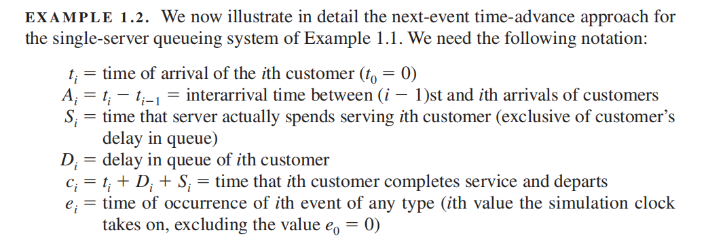
Example: Next Event Time Advance Mechanism

Slide 8
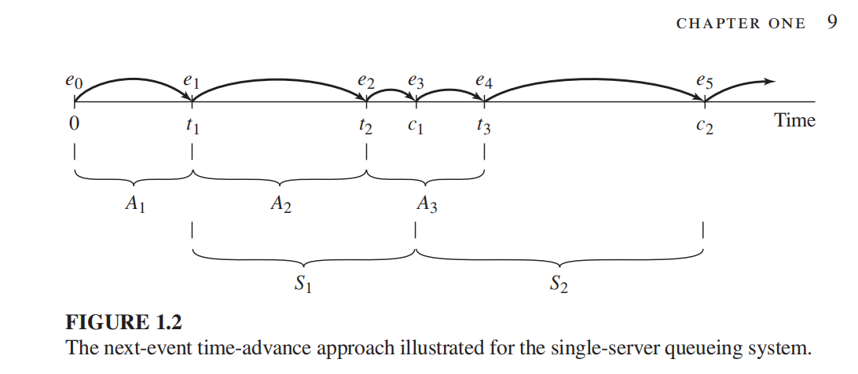
Example

